Slide 1


Indices and Data Aggregation
How to Get Data Insights?
SoftUni Team
Technical Trainers
Software University
https://softuni.bg

Slide 2
Table of Contents
Indices
Grouping
Aggregate Functions
Having Clause
2

Slide 3
Questions
sli.do #csharp-db

Slide 4


Indices
Clustered and Non-Clustered Indexes
Notes:
Every table can have only one clustered indexes. They are stored on the table. Clustered indexes sorts the data physically in the table so the reads are much faster. The most common index structure are the B-trees. However, when you have an index inserts and deletes it takes more time to accomplish because indexes has to be updated as well. A non-clustered index has a duplicate of the data from the indexed columns kept ordered together with pointers to the actual data rows (pointers to the clustered index if there is one). This means that accessing data through a non-clustered index has to go through an extra layer of indirection. However, if you select only the data that's available in the indexed columns you can get the data back directly from the duplicated index data.

Slide 5
Indices
Indices speed up the searching of values in a certain column or group of columns
Usually implemented as B-trees
Indices can be built-in the table (clustered) or stored externally (non-clustered)
Adding and deleting records in indexed tables is slower!
Indices should be used for big tables only (e.g. 500 000 rows).

Slide 6
Clustered Indices
Clustered index is actually the data itself
Very useful for fast execution of WHERE, ORDER BY and GROUP BY clauses
Maximum 1 clustered index per table
If a table has no clustered index, its data rows are stored in an unordered structure (heap).
Keys
0-99
100-199
200-299
Data
☰
☰
☰
☰
☰
☰
☰

Slide 7
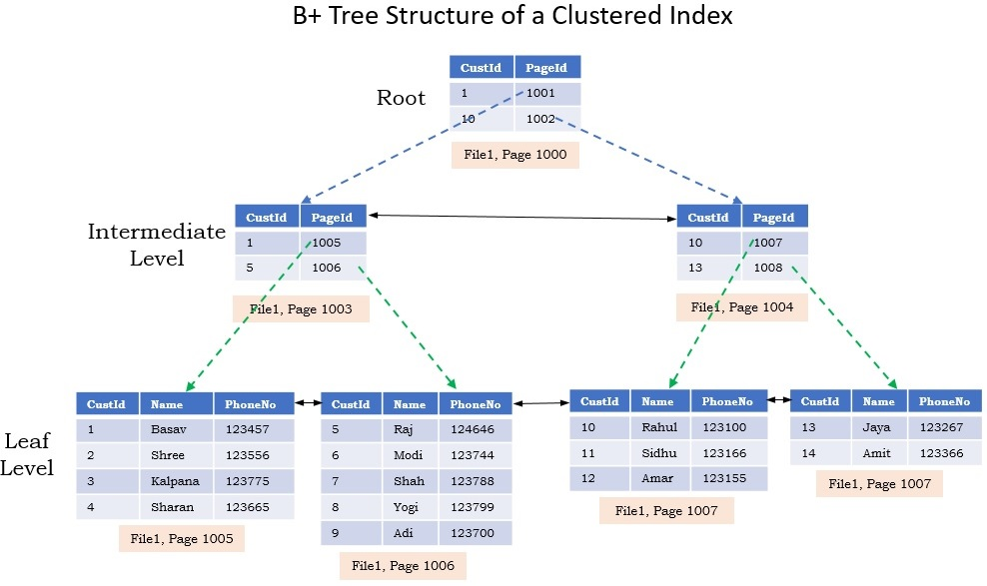
Clustered Indexes (2)

Slide 8
Non-Clustered Indeces
Useful for fast retrieving of a range of records
Maintained in a separate structure in the DB
Tend to be much narrower than the base table
Can locate the exact record(s) with less I/O
Has at least one more intermediate level than the clustered index
Much less valuable if a table doesn't have a clustered index

Slide 9
Non-Clustered Indexes (2)
A non-clustered index has pointers to the actual data rows (pointers to the clustered index if there is one).
Keys
Index
0-99
100-199
200-299
Range 1
Range 2
Range 3
Data
Links

Slide 10
Indices Syntax
Index Type
CREATE NONCLUSTERED INDEX IX_Employees_FirstName_LastName
ON Employees(FirstName, LastName)
Table Name
Columns

Slide 11

Demo: Index Performance
Live Demo

Slide 12

Grouping
Consolidating Data Based On Criteria

Slide 13
Grouping (1)
Grouping allows receiving data into separate groups based on a common property
Grouping column
Employee | DepartmentName | Salary
Adam
Database Support
5,000
Single row
John
Database Support
15,000
Can be aggregated
Jane
Application Support
10,000
George
Application Support
15,000
Lila
Application Support
5,000
Fred
Software Support
15,000
13

Slide 14
Grouping (2)
GROUP BY allows you to get each separate group and use an "aggregate" function over it (like Average, Min or Max):
DISTINCT allows you to get all unique values:
SELECT e.DepartmentID
FROM Employees AS e
GROUP BY e.DepartmentID
Group Columns
SELECT DISTINCT e.DepartmentID FROM Employees AS e
Unique Values
Notes:
When we use GROUP BY we can easily achieve distinct values. Grouping leaves only the unique combination of values.
Using the keyword DISTINCT is another way to eliminate the duplicate values. It simplifies the syntax because we don’t have to write down every single column in the GROUP BY part.

Slide 15
Problem: Departments Total Salaries
Use "SoftUni" database to create a query which prints the total sum of salaries for each department
Order them by DepartmentID (ascending)
Employee | DepartmentID | Salary
Adam | 1 | 5,000
John | 1 | 15,000
Jane | 2 | 10,000
George | 2 | 15,000
Lila | 2 | 5,000
Fred | 3 | 15,000
DepartmentID | TotalSalary
1 | 20,000
2 | 30,000
3 | 15,000
Check your solution here: https://judge.softuni.org/Contests/Practice/Index/291#12
Notes:
Use grouping to aggregate data. In order to achieve aggregation you need columns that will define the groups. In the case above we will use DepartmentID for aggregation purposes. The column has 3 unique values: "1", "2" and "3". Therefore, we will have 3 groups. Moreover, we can sum the salaries of the employees in those departments. If we add the Employee column we will have 6 groups because we have 6 unique combinations of values.

Slide 16
Solution: Departments Total Salaries
After grouping every employee by its department, we can use an aggregate function to calculate the total amount of money per group
Column Alias
SELECT e.DepartmentID,
SUM(e.Salary) AS TotalSalary
FROM Employees AS e
GROUP BY e.DepartmentID
ORDER BY e.DepartmentID
Table Alias
Group Columns
Check your solution here: https://judge.softuni.org/Contests/Practice/Index/291#12
Notes:
SQL provides the functionality by the statement GROUP BY. It is mandatory to have all the columns from the SELECT part in the GROUP BY part. On the other hand, it is possible to have columns in GROUP BY part but not in SELECT part. In this case the groups will be the same as if it was in the SELECT part but the missing columns wouldn't be visualized.

Slide 17

Aggregate Functions
COUNT, SUM, MAX, MIN, AVG…

Slide 18
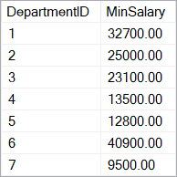
Aggregate Functions
Operate over (non-empty) groups
Perform data analysis on each one
MIN, MAX, AVG, COUNT, etc.
Aggregate functions usually ignore NULL values
SELECT e.DepartmentID,
MIN(e.Salary) AS MinSalary
FROM Employees AS e
GROUP BY e.DepartmentID

Slide 19
Aggregate Functions: COUNT
COUNT - counts the values in one or more grouped columns
Ignores NULL values
Employee | DepartmentName | Salary
Adam | Database Support | 5,000
John | Database Support | 15,000
Jane | Application Support | 10,000
George | Application Support | 15,000
Lila | Application Support | 5,000
Fred | Software Support | 15,000
DepartmentName | SalaryCount
Database Support | 2
Application Support | 3
Software Support | 1
Notes:
If any of the values are NULL they are ignored. For example, if one the values is NULL and the other is 5,000 the COUNT will return 1 because it will ignore the NULL value. On the other hand, we can count everything by writing COUNT(*).

Slide 20
COUNT Syntax
COUNT(ColumnName)
Note: COUNT ignores any employee with NULL salary
New Column Alias
SELECT e.DepartmentID,
COUNT(e.Salary) AS SalaryCount
FROM Employees AS e
GROUP BY e.DepartmentID
Group Columns

Slide 21
Aggregate Functions: SUM
SUM - sums the values in a column
Employee | DepartmentName | Salary
Adam | Database Support | 5,000
John | Database Support | 15,000
Jane | Application Support | 10,000
George | Application Support | 15,000
Lila | Application Support | 5,000
Fred | Software Support | 15,000
DepartmentName | TotalSalary
Database Support | 20,000
Application Support | 30,000
Software Support | 15,000

Slide 22
SUM Syntax
If any department has no salaries, it returns NULL
Grouping Column
New Column Alias
SELECT e.DepartmentID,
SUM(e.Salary) AS TotalSalary
FROM Employees AS e
GROUP BY e.DepartmentID

Slide 23
Aggregate Functions: MAX
MAX - takes the largest value in a column
Employee | DepartmentName | Salary
Adam | Database Support | 5,000
John | Database Support | 15,000
Jane | Application Support | 10,000
George | Application Support | 15,000
Lila | Application Support | 5,000
Fred | Software Support | 15,000
DepartmentName | MaxSalary
Database Support | 15,000
Application Support | 15,000
Software Support | 15,000
Notes:
NULLs are ignored again.

Slide 24
MAX Syntax
Grouping Column
New Column Alias
SELECT e.DepartmentID, MAX(e.Salary) AS MaxSalary
FROM Employees AS e
GROUP BY e.DepartmentID
Group Columns

Slide 25
Aggregate Functions: MIN
MIN - takes the smallest value in a column
Employee | DepartmentName | Salary
Adam | Database Support | 5,000
John | Database Support | 15,000
Jane | Application Support | 10,000
George | Application Support | 15,000
Lila | Application Support | 5,000
Fred | Software Support | 15,000
DepartmentName | MinSalary
Database Support | 5,000
Application Support | 5,000
Software Support | 15,000

Slide 26
MIN Syntax
New Column Alias
SELECT e.DepartmentID, MIN(e.Salary) AS MinSalary
FROM Employees AS e
GROUP BY e.DepartmentID
Group Columns

Slide 27
Aggregate Functions: AVG
AVG - calculates the average value in a column
Employee | DepartmentName | Salary
Adam | Database Support | 5,000
John | Database Support | 15,000
Jane | Application Support | 10,000
George | Application Support | 15,000
Lila | Application Support | 5,000
Fred | Software Support | 15,000
DepartmentName | AvgSalary
Database Support | 10,000
Application Support | 10,000
Software Support | 15,000

Slide 28
AVG Syntax
New Column Alias
SELECT e.DepartmentID,
AVG(e.Salary) AS AvgSalary
FROM Employees AS e
GROUP BY e.DepartmentID
Group Columns

Slide 29
Aggregate Functions: STRING_AGG
STRING_AGG - Concatenates the values of string expressions and places separator values between them. The separator is not added at the end of string
Expressions are converted to NVARCHAR or VARCHAR types during concatenation. Non-string types are converted to NVARCHAR type
STRING_AGG ( expression, separator )
[WITHIN GROUP ( ORDER BY expression [ ASC | DESC ] )]

Slide 30

Having
Using Predicates While Grouping
Notes:
The HAVING clause is used to filter data based on aggregate values. This means that we cannot use it without grouping before that. Unlike HAVING, the WHERE clause filters rows before the aggregation happens.

Slide 31
HAVING Clause
The HAVING clause is used to filter data based on aggregate values
We cannot use it without grouping first
Aggregate functions (MIN, MAX, SUM etc.) are executed only once
Unlike HAVING, WHERE filters rows before aggregation
31

Slide 32
HAVING Clause: Example
Filter departments having total salary more than or equal to 15,000
Aggregated value
Employee | DepartmentName | Salary
Adam | Database Support | 5,000
John | Database Support | 15,000
Jane | Application Support | 1,000
George | Application Support | 5,000
Lila | Application Support | 5,000
Fred | Software Support | 15,000
TotalSalary
20,000
11,000
15,000
DepartmentName | TotalSalary
Database Support | 20,000
Software Support | 15,000

Slide 33
HAVING Syntax
Aggregate Function
Column Alias
SELECT e.DepartmentID, SUM(e.Salary) AS TotalSalary
FROM Employees AS e
GROUP BY e.DepartmentID
HAVING SUM(e.Salary) >= 15000
Grouping Columns
Having Predicate

Slide 34

Summary
…
…
…
Grouping by Shared Properties
Aggregate Functions
Having Clause
SELECT
SUM(e.Salary) AS 'TotalSalary'
FROM Employees AS e
GROUP BY e.DepartmentID
HAVING SUM(e.Salary) >= 15_000

Slide 35
Questions?
Notes:
35

Slide 36












SoftUni Diamond Partners

Slide 37


Educational Partners

Slide 38
Trainings @ Software University (SoftUni)
Software University – High-Quality Education, Profession and Job for Software Developers
softuni.bg, about.softuni.bg
Software University Foundation
softuni.foundation
Software University @ Facebook
facebook.com/SoftwareUniversity
Software University Forums
forum.softuni.bg
38
Notes:
38

Slide 39

License
This course (slides, examples, demos, exercises, homework, documents, videos and other assets) is copyrighted content
Unauthorized copy, reproduction or use is illegal
© SoftUni – https://about.softuni.bg
© Software University – https://softuni.bg
Notes:
39

